Slide 1



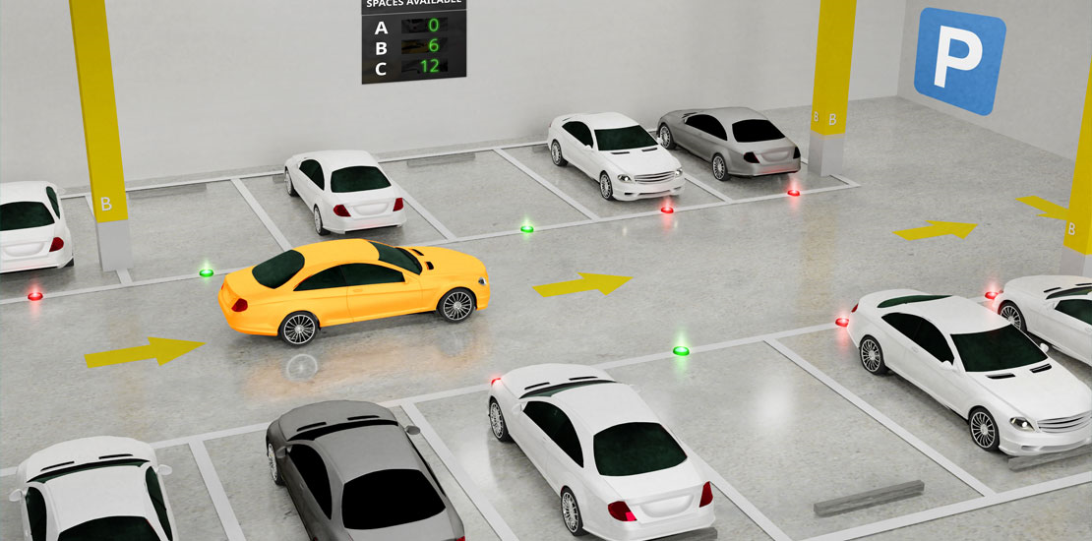
SMART CAR
PARKING
SYSTEM
Presented by: G PRISCILLA RACHEL - 210701196
J RACHEL SHERIN - 210701200

Slide 2

Overview
Introduction
Purpose of the Project
Circuit Diagram
Results
Conclusion and Future scope

Slide 3

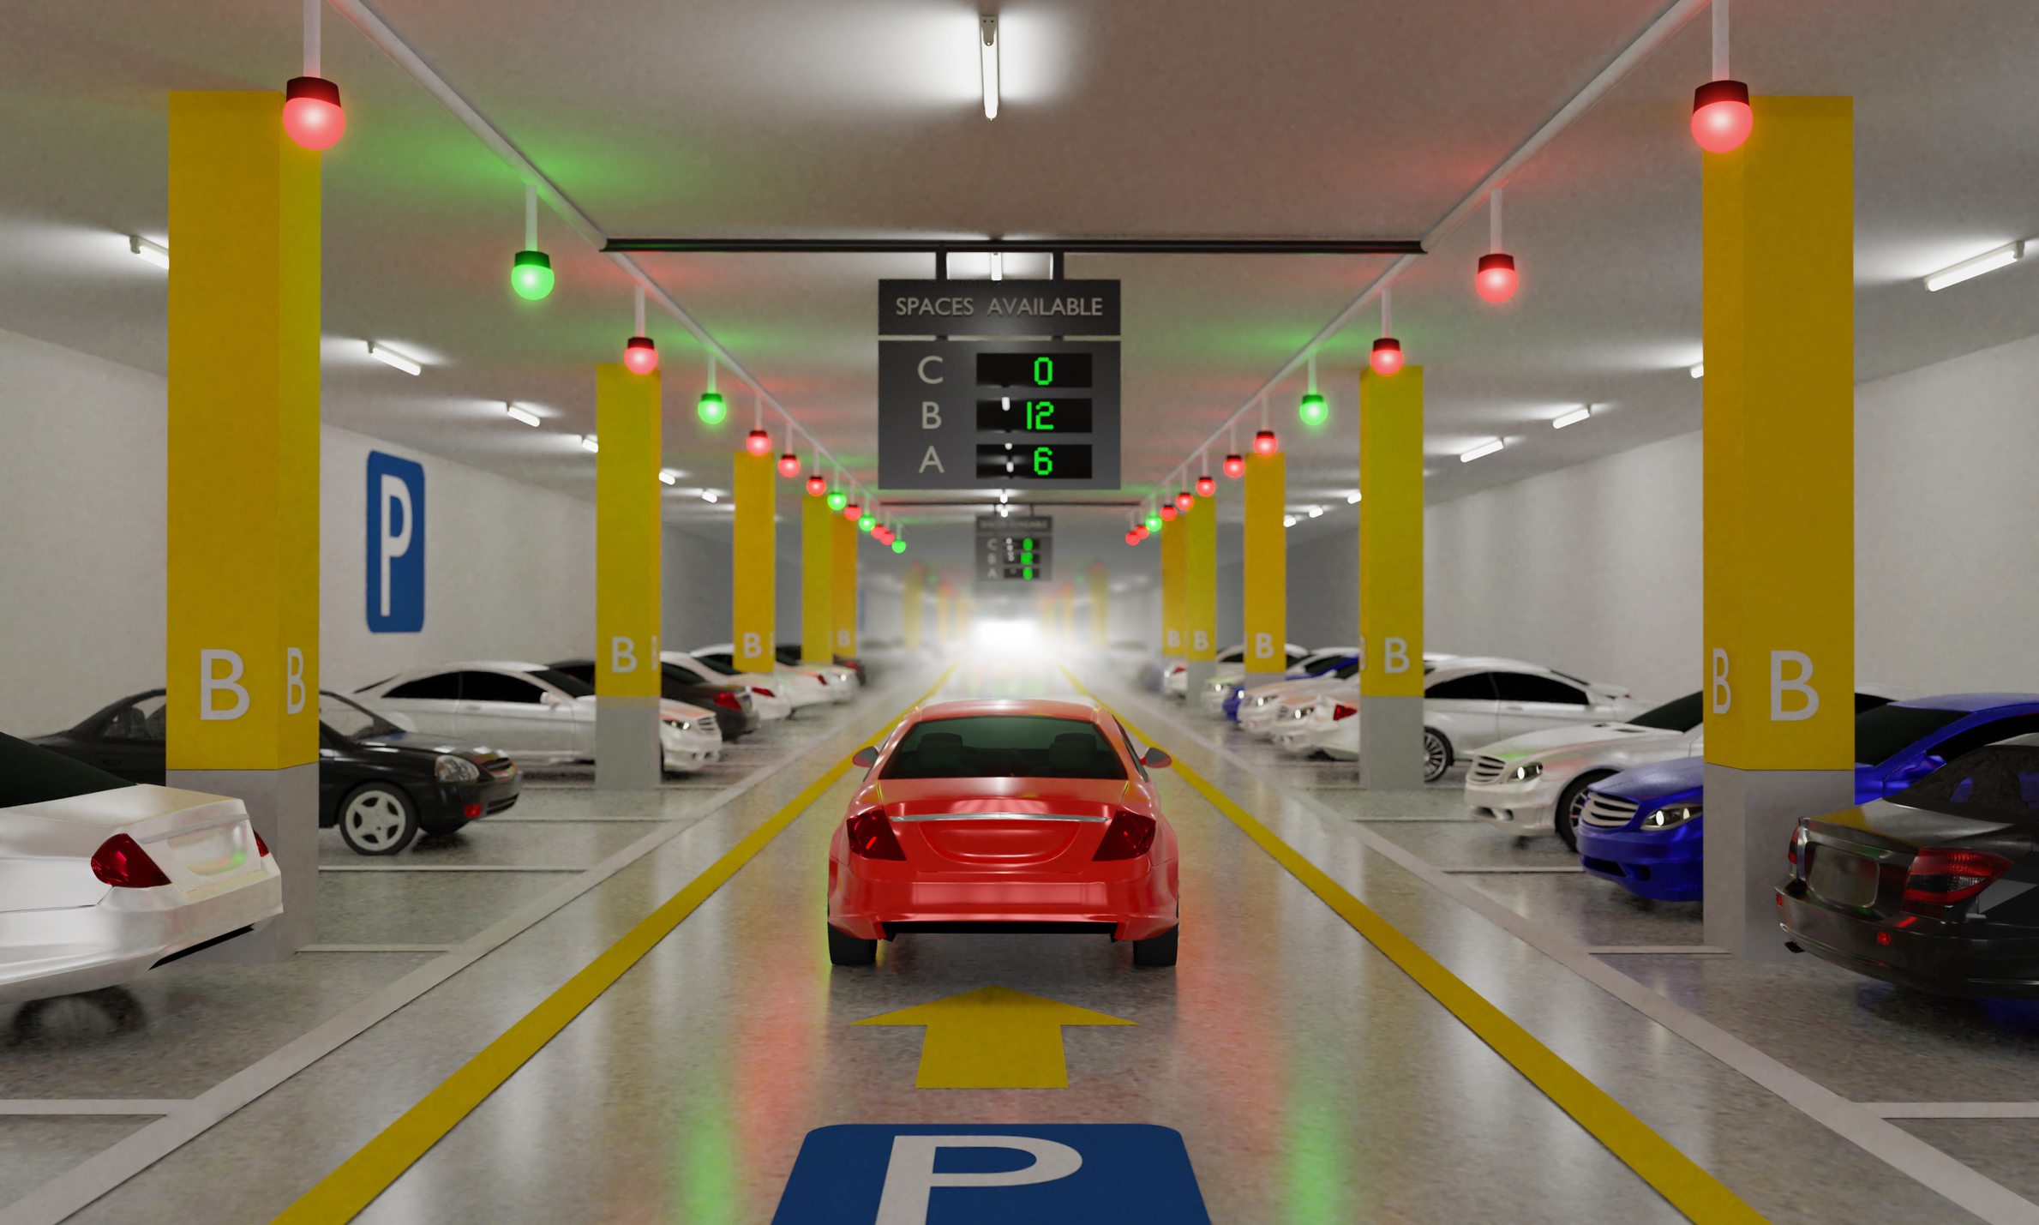
INTRODUCTION
Smart Car Parking System Using IoT:
This project involves the design and implementation of a smart car parking system that leverages Internet of Things (IoT) technologies to enhance urban parking management.
Efficiency and Convenience:
The system provides real-time updates on parking slot availability via an LCD display and automates entry and exit barriers, significantly reducing search time for drivers, alleviating traffic congestion, and optimizing space utilization in parking facilities.

Slide 4
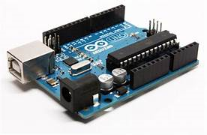
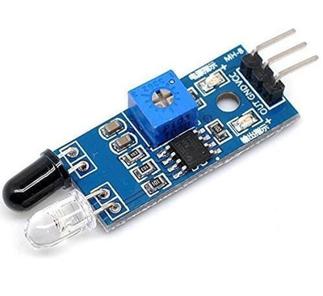
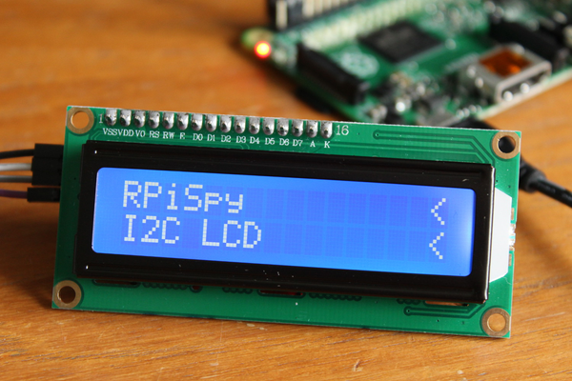
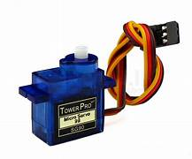
COMPONENTS USED
Arduino Uno
IR Sensors
Servo Motor
LCD Display
The Arduino microcontroller serves as the brain of the system. It processes input data from various sensors, controls the display and servomotors, and manages overall system operations.
IR sensors detect the entry or exit of vehicles in the parking area . They emit infrared light and detect the reflected signal to determine the entry and exit of vehicles
The LCD display provides real-time information on the number of available parking slots to drivers entering the facility. This helps in reducing search time and improving user convenience.
Servomotors control the barriers or gates at the entrance and exit of the parking facility. They receive signals from the Arduino to open or close based on parking slot availability.

Slide 5

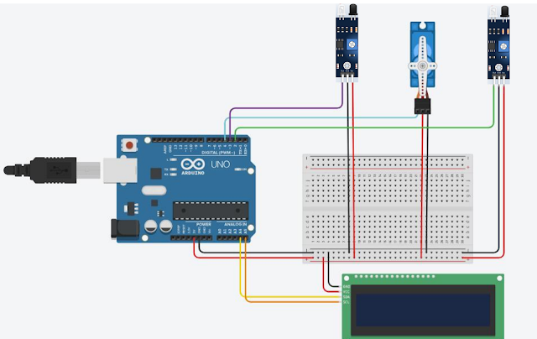



CIRCUIT DIAGRAM

Slide 6

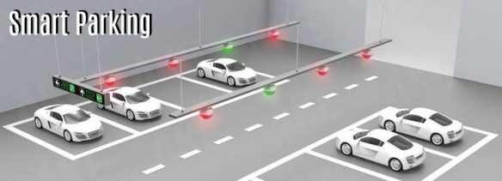
RESULT
Real-Time Updates: Successfully provided real-time updates on parking slot availability via an LCD display.
Automated Control: Streamlined vehicle flow with automated entry and exit barriers controlled by servomotors.
Enhanced Efficiency: Reduced time spent searching for parking and improved space utilization.
Traffic Reduction: Contributed to decreased traffic congestion and enhanced overall parking management.
.

Slide 7
Conclusion
Improved Efficiency: The smart car parking system significantly reduced the time drivers spent searching for available parking slots, leading to better space utilization and reduced traffic congestion.
User Convenience: Real-time updates and automated barrier controls enhanced the overall user experience, making parking more straightforward and stress-free.
Scalability and Integration: The system's design allows for future expansions and integration with mobile applications and advanced data analytics, promising further improvements in urban parking management.

Slide 8

Future Scope
1.Mobile Application Integration: Develop a mobile app to allow users to check real-time parking availability, make reservations, and receive notifications, enhancing user convenience and engagement.
2.Advanced Sensor Technology: Incorporate advanced sensors, such as ultrasonic or camera-based systems, for more precise vehicle detection and enhanced reliability.
3.Data Analytics and Predictive Management: Implement data analytics and machine learning algorithms to analyze usage patterns, predict parking demand, and optimize space allocation, further improving efficiency and planning.

Slide 9



THANKYOU

